Slide 1
Digital Engineering 1
Lecture 6-1

Slide 2
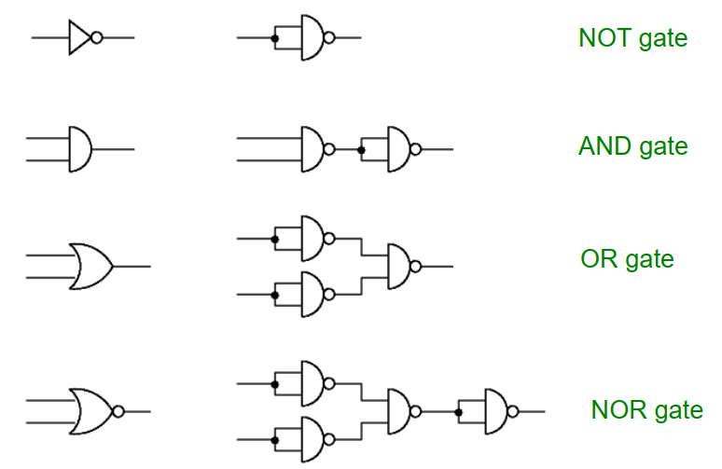
Gate equivalents using 2-input NAND gates

Slide 3
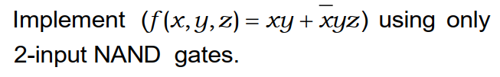
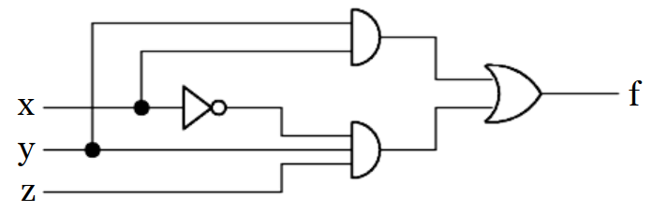
Create an AND/OR circuit

Slide 4
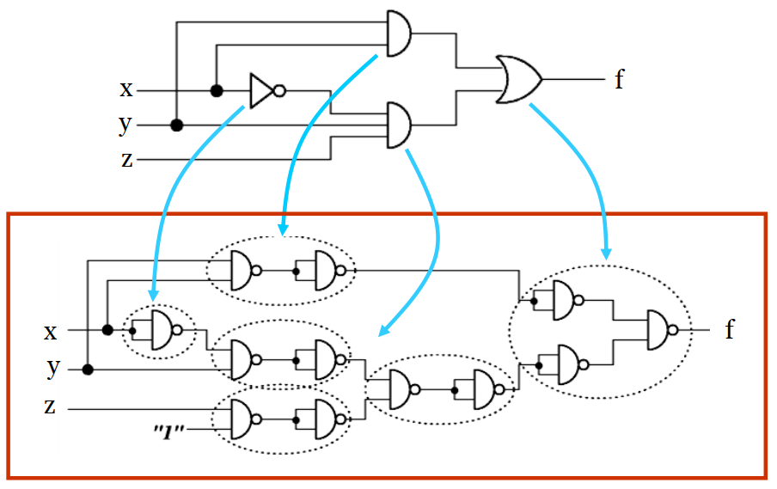
2. Substitute all logic gates by equivalent 2-input NAND gates

Slide 5
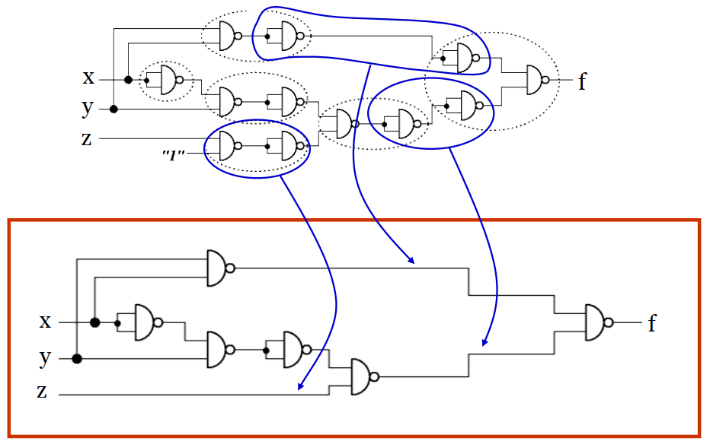
3. Remove redundant NAND gates

Slide 6
Don’t Care Input Combinations
Sometimes functions are incompletely specified; the function is not defined for some minterms.
outputs really don’t matter when these input combinations occur,
Or
these input combinations never occur in normal operation.
These input combinations are known as don’t care conditions.
Don’t cares are entered as X’s in the K-map (sometimes D or d are also used).
During simplification, X’s can be treated as 1’s or 0’s.

Slide 7
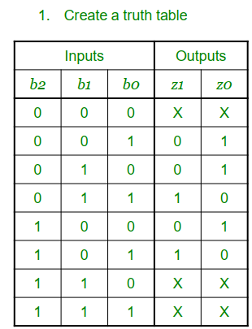


z0
b1b0
 | 00 | 01 | 11 | 10
0 | X | 1 |  | 1
1 | 1 |  | X | X
b2
z1
b1b0
 | 00 | 01 | 11 | 10
0 | X |  | 1
1 |  | 1 | X | X
b2

Slide 8
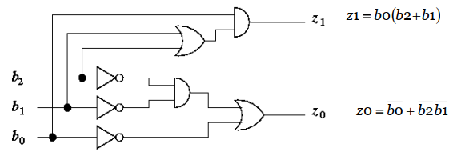
Gate level implementation

Slide 9
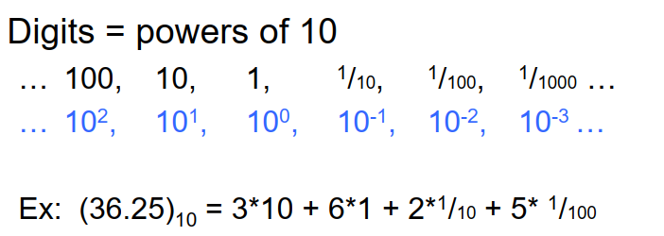
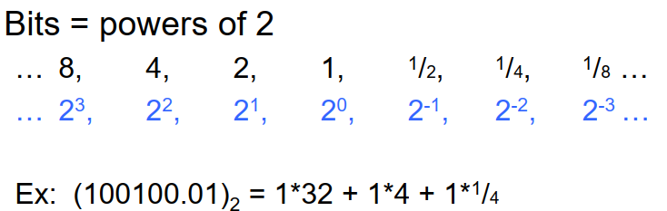
Digits vs. bits

Slide 10
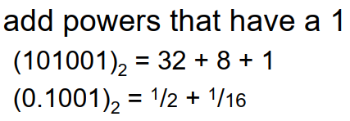

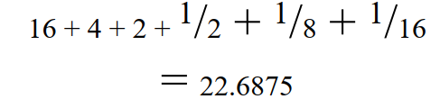
Binary to decimal

Slide 11
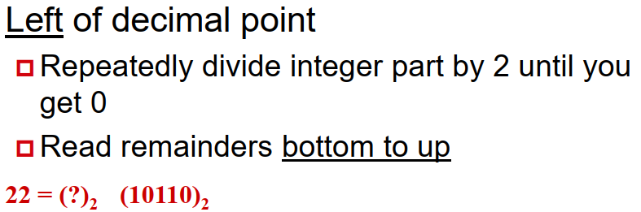
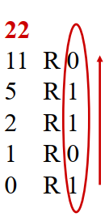
Decimal to binary

Slide 12
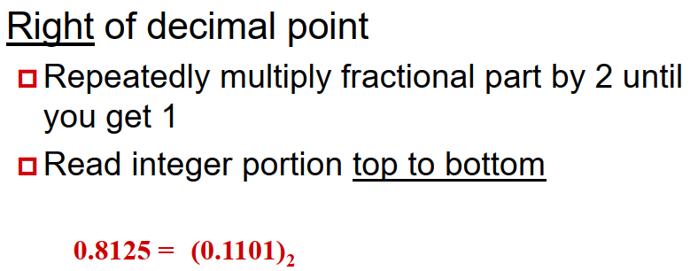
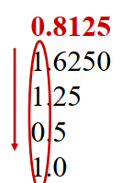
Decimal to binary

Slide 13

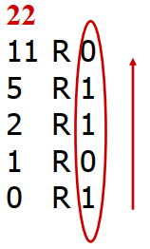
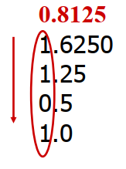
Decimal to binary

Slide 14
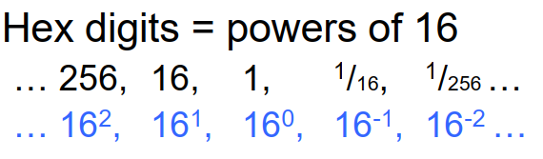
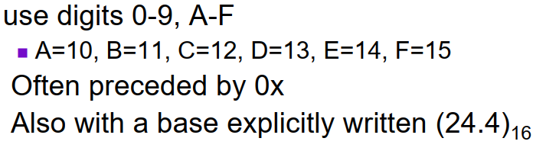
Hexadecimal base
Notes:
Exercises  3.25 = (?)2  0.0101 = (?)10  0.3 = (?)2  114.25 = (?)2  1010001.01101 = (?)10  0101.0101 = (?)10  1010.0101 = (?)10

Slide 15
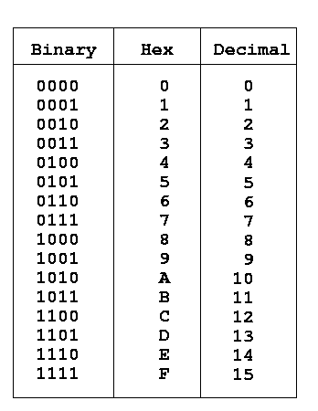
Hexadecimal base

Slide 16
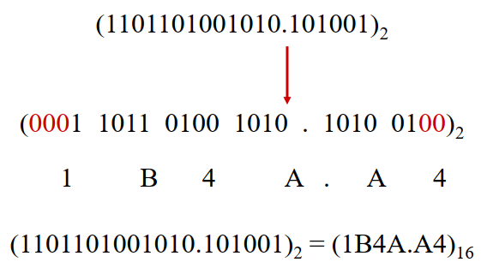
Hex (hexadecimal) Group from decimal point outward
Pad with zeros to get groups of 4

Slide 17

Octal base
Octal digits = powers of 8
… 64, 8, 1, 1/8, 1/64 …
… 8², 8¹, 8⁰, 8⁻¹, 8⁻² …
use digits 0-7
sometimes preceded by 0
Also with a base explicitly written(24.4)₈

Slide 18
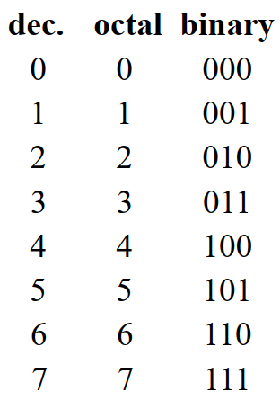
Octal base
Octal
Octal digits are groups of 3 bits
Pad with zeros

Slide 19
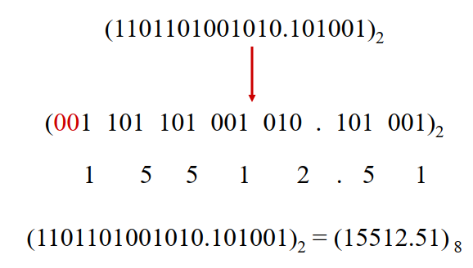
Binary to Octal
Octal
Group from decimal point outward
Pad with zeros to get groups of 3

Slide 20
Other conversions
What about other conversions such as: Octal → Hex Decimal → Hex
Use other conversions you already know Octal → Binary → Hex Decimal → Binary → Hex

